Slide 1
Programming in Scratch
Lesson 5: Selection and logical operators

Slide 2
Objectives
In this lesson, you will learn how to use:
multiple condition checks with if-else statements
logical operators within if-else statements.

Slide 3

Meeting the criteria
Write down how many of the shapes meet the criteria below:
square AND circle
square OR circle
red OR circle
black AND square
red NOT square

Slide 4
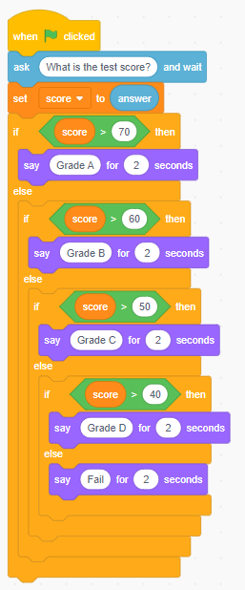
Selection
In the last lesson, we looked at how selection can involve more than one condition.
Look at this program and write down what it would output for the following values:
  score = 42
  score = 60
  score = 68
  score = 90
  score = 23

Slide 5

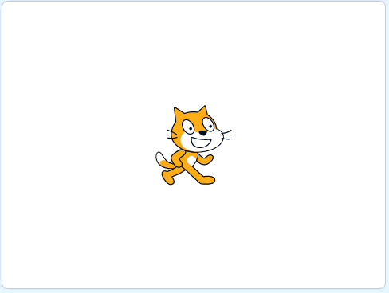
Activity 5.1: Water state
Example of finished solution

Slide 6
Logical operators
Logical operators return a Boolean value, a value that can be only True or False.
There are three logical operators that can be used in programming to help determine what a program should do. These are:
and both conditions must be true
or at least one condition must be true
not anything but what is being asked for

Slide 7
The and operator
The and operator allows for two conditions to be checked.
For it to return True, both conditions must be true.
Here are some examples:
Statement | Returns | Reason
(10 > 12) AND (15 > 10) | False | Only one condition is true. 10 is not more than 12.
(A = A) AND (C = C) | True | Both conditions are true.
(5.5 < 3) AND (G = F) | False | Both conditions are false.

Slide 8
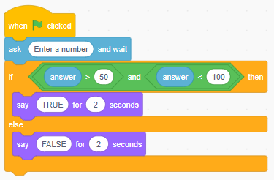
Using and in Scratch
Here is an example of and being used in Scratch:
If 120 is entered, the program would say FALSE. 120 is more than 50 but it is not less than 100 so both conditions are not met.
If 67 is entered, the program would say TRUE. 67 is more than 50 and less than 100 so both conditions are met.

Slide 9
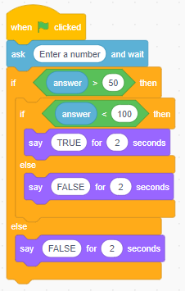
Why use logical operators?
These programs both work in the same way, but the first one uses the logical operator and inside the if-else statement. This means that only one if-else statement is needed, simplifying the program and making it easier to follow.

Slide 10
The or operator
The or operator allows for two conditions to be checked.
For it to return True, at least one condition must be true.
Here are some examples:
Statement | Returns | Reason
(10 > 12) AND (15 > 10) | True | At least one condition is met. 15 is more than 10.
(A = A) AND (C = C) | True | Both conditions are true.
(5.5 < 3) AND (G = F) | False | Both conditions are false.

Slide 11
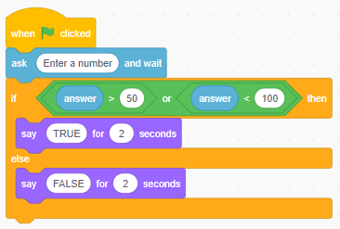
Using or in Scratch
Here is an example of or being used in Scratch:
If 120 is entered, the program would say TRUE. 120 is more than 50 and it doesn’t matter if it isn’t less than 100 because only one condition needs to be met.
If 67 is entered, the program would say TRUE. 67 is more than 50 and less than 100 and at least one condition needs to be met.

Slide 12
The not operator
The not operator allows for one condition to be checked.
For it to return True, the value has to be anything but the value being asked for. Here are some examples:
Statement | Returns | Reason
C = NOT(B) | True | The letter C is NOT the letter B.
15 = NOT(14) | True | The number 15 is NOT the number 14.
14 = NOT(14) | False | The number 14 is the number 14.

Slide 13
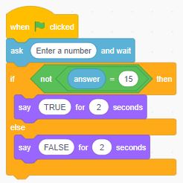
Using not in Scratch
Here is an example of not being used in Scratch:
If 14 was entered, the program would say TRUE because the number entered is NOT 15.
If 15 is entered, the program would say FALSE because the number entered IS 15.

Slide 14
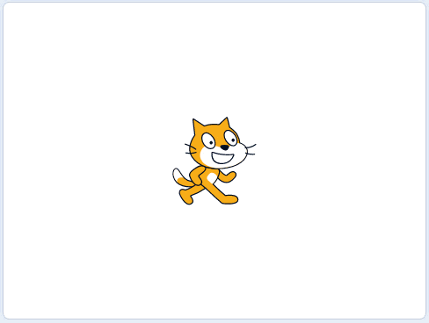
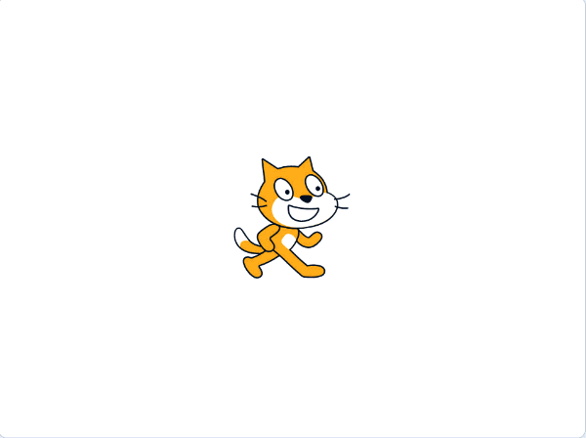
Activity 5.2: What is the weather like?
Example of finished solution
Example of extension 1

Slide 15
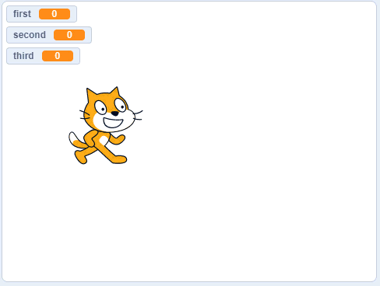
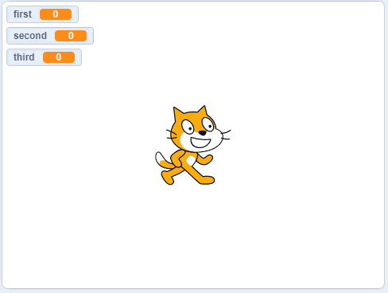

Activity 5.3: Same!
Example of finished solution
Example of extension 1
Example of extension 2

Slide 16
Question 1
How many conditions need to be true for the and operator to return True?

Slide 17
Question 2
How many conditions need to be true for the or operator to return True?

Slide 18

Question 3
What is the problem with the and operator in this program?

Slide 19
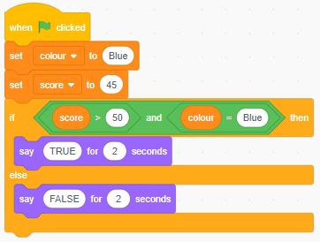
Question 4
What would this program output?

Slide 20
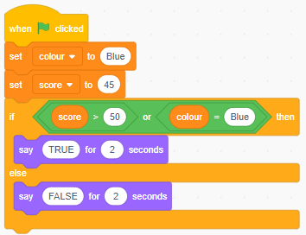
Question 5
What would this program output?

Slide 21
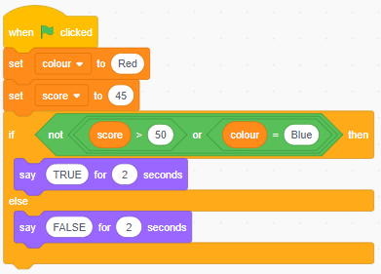
Question 6
What would this program output?

Slide 22
Quiz 5

